Slide 1
Sean Koppenhafer, Jaime Rodriguez,
Chad Thueson, Noah Erickson, Rishal Dass
Weekly meeting, 3/11/2015 (Week 10)
Digital Dash
Portland State University
Department of Electrical and Computer Engineering (ECE)
Notes:
<number>
<number>

Slide 2
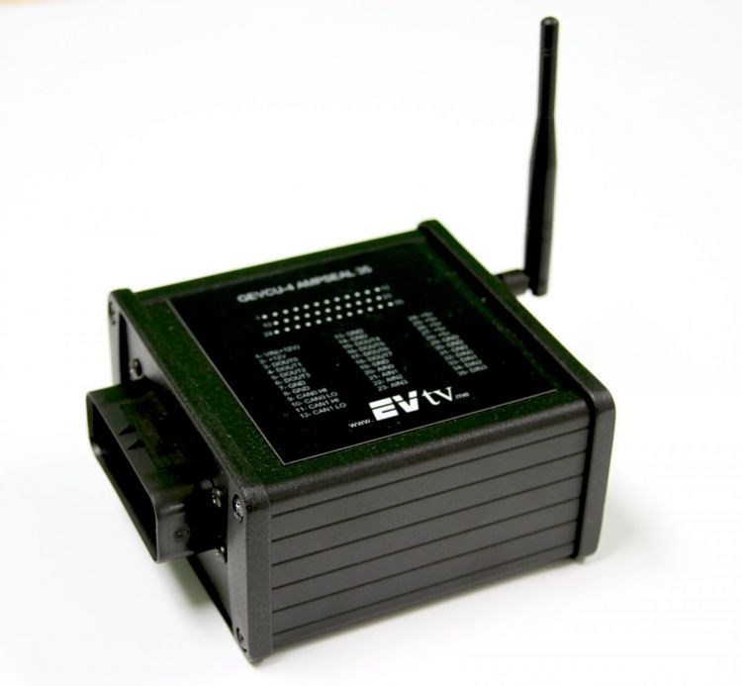
CAN Updates
Completed
Problems
RMS messages confirmed as accurate.
Correct scaling factors found.
BMS messages still are a no go
Looks fine on the scope
No readings at all baud rates
Solutions
Michal has been emailed again about this issue. We are out of ideas.

Slide 3
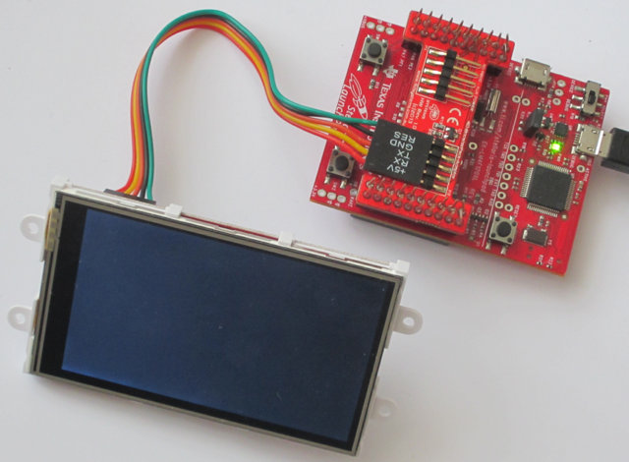
Screen Updates
Screen looks pretty good in sunlight.
Looks even better with polarizing shield.
May be possible to add more LEDs.
May be possible to overdrive LEDs on it.
Displayed temperatures and voltages.
Created two layouts for testing.

Slide 4
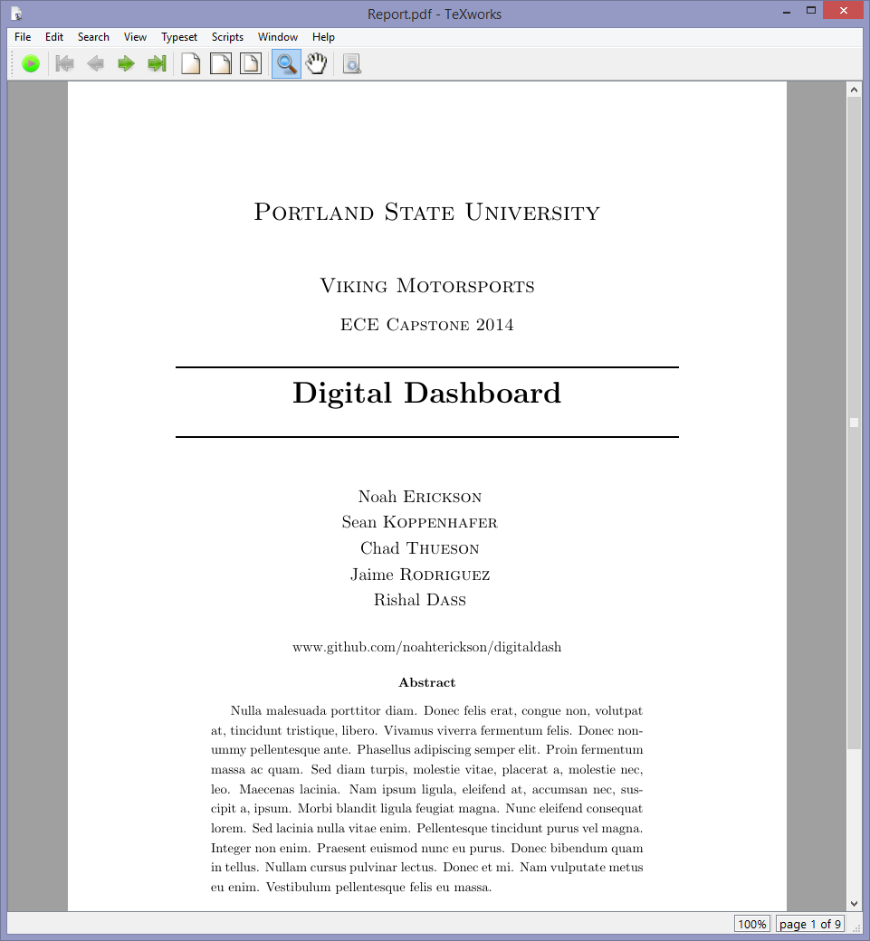
Documentation Updates
Looked into using Shared Latex
Began to tidy up the code
Project is mostly on schedule – BMS
messages are slowing us down

Slide 5
Goals For The Upcoming Week
CAN
Troubleshoot with Michal to debug BMS issues
Enclosure
Start working on enclosure layouts
Board Layout
- Finalize board layout
Code Cleanup
- Continue to tidy up the code
Notes:
<number>

